Slide 1
Applications of Latent Class Mixed Models in CF Infant Airway Microbiomes
Casey Sakamoto
Committee: Brandie Wagner, Elizabeth Juarez-Colunga, Jonathan Harris

Slide 2
Cystic Fibrosis (CF)
Hereditary disease which involves production of mucus which is much more viscous than usual
Early airway vulnerability to chronic bacterial infections
Most common life-threatening autosomal recessive disease in US
Affects 1 in 4000 newborns
No known cure
Notes:
Slide Purpose: Background info on CF- what is it, who does it affect
Mucus is difficult to expel from lungs
(3)All newborns (US) screened for CF
(4) Higher rates in some European countries

Slide 3
Cystic Fibrosis (CF) cont.
Subjects have varied disease progression
Unclear whether variability present in early CF airways, or if it develops over time
Identifying endotypes based on airway microbiome community composition may clarify this
Microbiome data complex
Notes:
Slide Purpose: Background info on CF- motivate analysis of the microbiome
Better understanding of early airway infections -> better understand variability of disease progression

Slide 4
Microbiome Data
Requires consideration of location & quantity of samples
Number of samples collected could often be limited
Sequencing of a specimen provides estimate of the relative abundance of different species within a sample
Potential lack of measurement precision provides some difficulty in conclusions drawn
Relative Abundances sum to 1; many standard statistical methods inappropriate here
Notes:
Slide Purpose: Insight into complexity of microbiome data
mention how microorganisms on/in the human body outnumber human cells tenfold, Can be used to identify diff between members of a family, community, or across different popns
Left:
Are our samples representative of our population (true mb comp); could it change based on location of sample (upper vs lower airways)
Limited based on difficulty of collecting the samples (is the procedure invasive? Is Location precision important?)
Right: pearson’s correlation coefficient, ANOVA, linear regression, t-tests

Slide 5
Latent Class Analysis: A “Classy” Take on Microbiome Data
The latent class mixed model is a sub-genre of structural equation modeling
Very similar to cluster analysis
Incorporates a linear mixed model framework into the modeling of unmeasured groups (endotypes) to fit longitudinal data
Notes:
SP: introduce the method & a general connection to the main thesis question
(3) Mention the unmeasured groups are the latent variables, will explain in a bit

Slide 6
Latent Class Analysis: A “Classy” Take on Microbiome Data
Application of Latent Class Analysis methods to microbiome still relatively novel
Especially longitudinal airway microbiome data
Few assumptions on the data; appealing for microbiome data
Normality assumption can be met via compositional transformations
Notes:
Slide purpose: to present LCA as a method of analyzing mb data
Several papers have emphasized the utility of building these models (in tangential areas of interest of the microbiome: true bacterial community composition, identifying phenotypes, Bayesian versions of SEM)
Hasn’t really been any applications applying lcmm to longi mb data (very novel application)
Really, the only main assumption is the outcomes are norm dist

Slide 7
Building a Latent Class Mixed Model: What is a Latent Variable?
Latent Variable: A variable for which there is no sample realization for at least some (sometimes all) observations in a sample
We can’t measure self-esteem (latent), but can use the compiled answers on a questionnaire (Observed r.v.) to glean info about it
If we treat groups/clusters of subjects as a latent variable, we can use the measured composition of their microbiome communities (trajectories) to build these endotypes
Notes:
SP: define latent variables, introduce idea of using lv to build endotypes
Undefined endotypes are the groups clusters

Slide 8
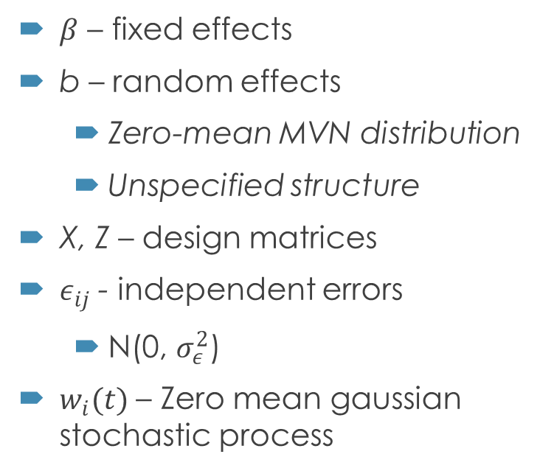
Building a Latent Class Mixed Model: Linear Mixed Model recap
$β$ – fixed effects
b – random effects
Zero-mean MVN distribution
Unspecified structure
X, Z – design matrices
$ε_{ij}$ - independent errors
N(0, $σ_{ε}^{2}$)
$w_{i}(t)$ – Zero mean gaussian stochastic process
Assume normally distributed measurement errors, random effects, correlated errors
Assume constant covariate effects across time
Notes:
SP: recap LMM
For subject i, repeated measure j
Design matrix trajectory shapes can be of any type (polynomial, specifically designed to the fit, spline methods)
w(t) ZM gaussian stoch process or stationary process w parameter $σ_{w}^{2}$; included in semiparametric lmm, used to model serial correlation

Slide 9
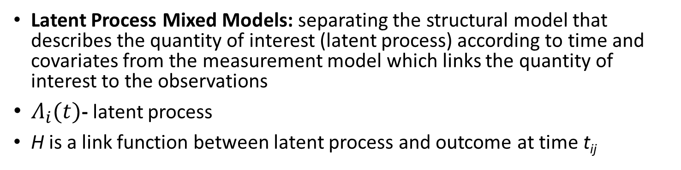
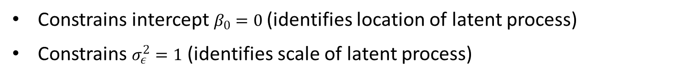
Building a Latent Class Mixed Model: Latent Process Mixed Model
Latent Process Mixed Models: separating the structural model that describes the quantity of interest (latent process) according to time and covariates from the measurement model which links the quantity of interest to the observations
$Λ_{i}(t)$- latent process
H is a link function between latent process and outcome at time t_{ij}
Constrains intercept $β_{0}=0$(identifies location of latent process)
Constrains $σ_{ε}^{2}=1$ (identifies scale of latent process)
Notes:
SP: introduce a latent model
Latent process- standard lmm w/o error
Several options for H in package lcmm, but we are going to opt for a compositional transform on the outcome instead

Slide 10

Building a Latent Class Mixed Model: Latent Process Mixed Model
Extended to Multivariate case with K longitudinal markers (such as bacterial taxa)
Similar constraints as in univariate case
Also requires a random intercept
Notes:
SP: multivariate case
Requires random intercept, because the dimension of the latent process constrained by intercept (B0=0) and variance of random intercept rather than se of a marker specific standard error

Slide 11
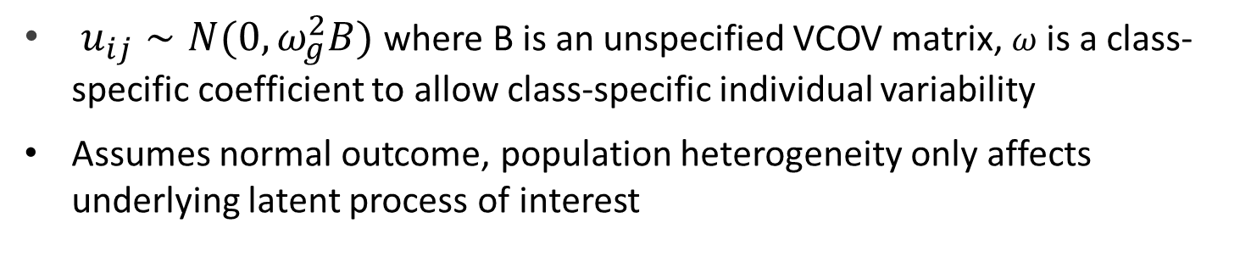
Building a Latent Class Mixed Model: Latent Class Mixed Model
Assume a heterogenous population with G latent classes of subjects (each subject belongs to one class)
C_{i} is a discrete random variable; P(C_{i} = g) is class-specific probability
$u_{ij}∼N(0,ω_{g}^{2}B)$ where B is an unspecified VCOV matrix, $ω$ is a class-specific coefficient to allow class-specific individual variability
Assumes normal outcome, population heterogeneity only affects underlying latent process of interest
Notes:
SP introduce the method to be used in the thesis
-G fixed
- Linear mixed model for a normal outcome Yij in class g
- This is extended to a latent process model
The difference with a standard linear mixed model is that both fixed effects and the distribution of the random effects can be class-specific
We can take covariates and model them in different ways: standard fixed effects, class specific, and marker specific covariates (multivariate case)

Slide 12

Building a Latent Class Mixed Model: Latent Class Mixed Model
The variable c_{i} can be described using a multinomial logistic model according to covariates X_{ci}
Notes:
SP introduce the method to be used in the thesis
xi (ksee) is the Greek letter
These are class specific covariates
When no covariate predicts the latent class membership, this model reduces to a class-specific probability
When we model, we need to pre specify the number of latent classes – leads to fitting of many models

Slide 13

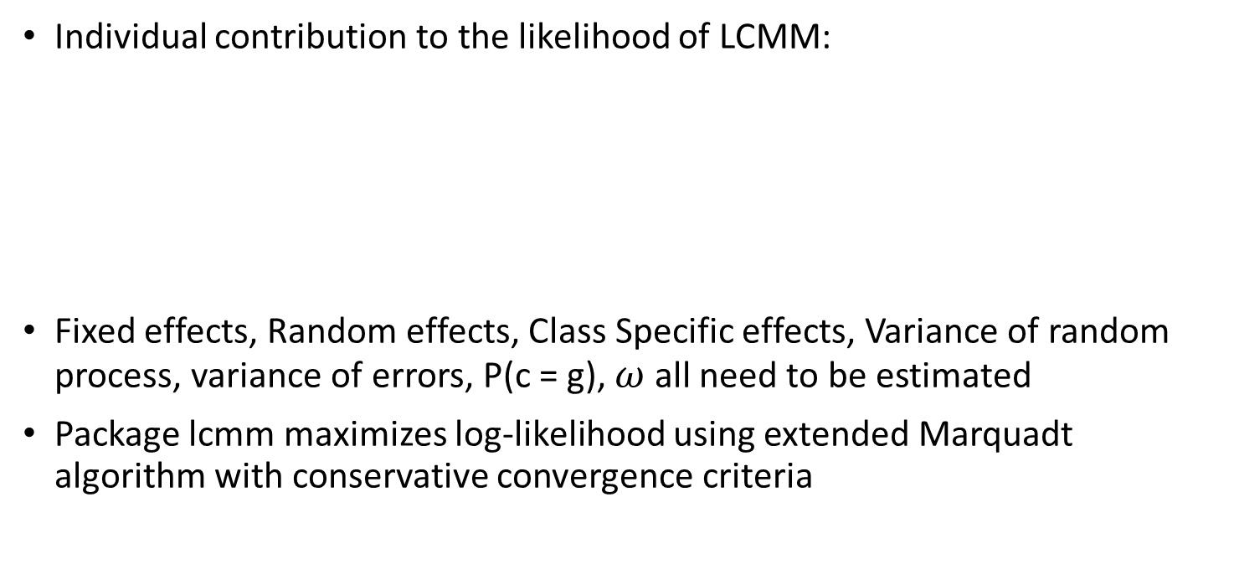
Building a Latent Class Mixed Model: Parameter Estimation
Individual contribution to the likelihood of LCMM:
Fixed effects, Random effects, Class Specific effects, Variance of random process, variance of errors, P(c = g), $ω$ all need to be estimated
Package lcmm maximizes log-likelihood using extended Marquadt algorithm with conservative convergence criteria
Notes:
SP: define parameters estimated, how they are estimated, likelihood form
Omega is class specific variability parameter;
Marquadt algorithm in newton Raphson family of algortihms
Convergence of log lik based on 3 criteria: stability of log lik, stability of parameters, size of derivatives (important we have three because some likelihood shapes can be quite flat in certain areas of param space)

Slide 14
Building a Latent Class Mixed Model: Parameter Estimation (Multiple Classes)
In mixture modeling, log-likelihood may have multiple maxima
Convergence towards global maximum not guaranteed running model only once
Each model run several different times from different sets of initial values
Draws from asymptotic distribution of MLE of the G = 1 model

Slide 15
Motivating example: BONUS STUDY
231 infants within 28 centers in the US
Over 1,000 throat swabs collected from 205 infants over the first year of life
Clinical, medication, symptoms, culture, and chest radiographs data
194 infants (84%) developed a CF specific pathogen
Relatively low number of taxa within the collected samples
Further Reference: Goetz et al 2019

Slide 16
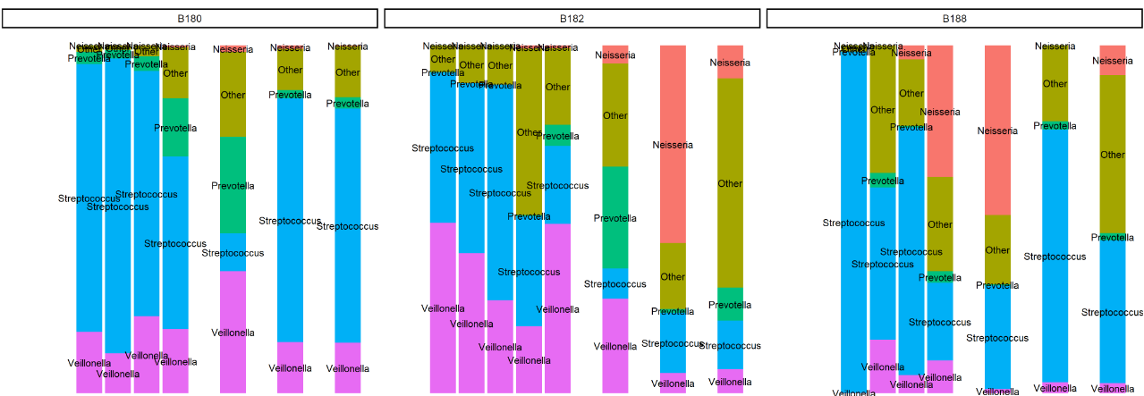
Motivating example: BONUS STUDY
Different Veillonella trajectories in each subject
Latent classes present?
Notes:
Sp: show some trajectories are different; maybe they could be classified into endotypes from to these trajectories
Mention here they were grouped into 5 groups: Veillonella, streptococcus, Prevotella, Neisseria, and other at “genus” level → non specified genus were in other

Slide 17
The Thesis
Identifying endotypes based on airway microbiome community composition may help elucidate whether infants start with a similar microbiome that changes over time or are the observable differences in subject microbiomes due to inherent subject variability
How many latent classes are there; can we build these classes using Latent Class Analysis?
When we build these classes what covariates are associated with our clusters?
Notes:
If we can identify these endotypes using microbiome trajectories, we could figure out whether infants start with a similar mirobiome and it changes over time, or if the differences we observe are due to inherent subject variability
Covariates associated with class membership, not the longitudinal markers

Slide 18
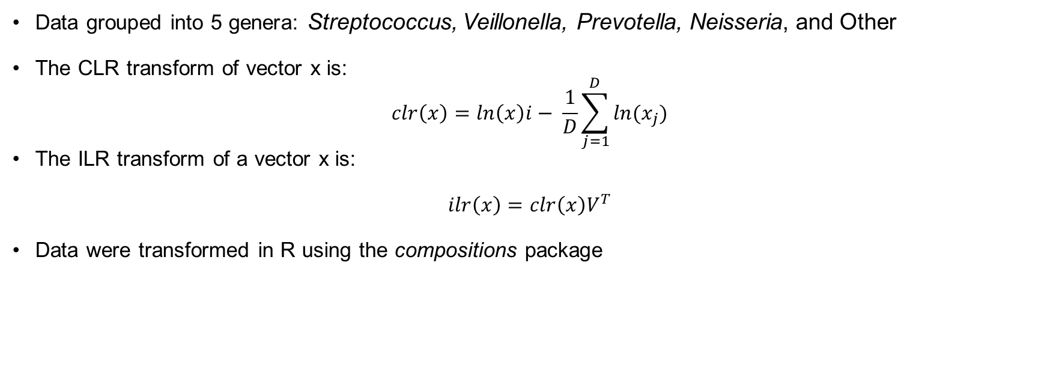
Methods: Data Manipulation
Data grouped into 5 genera: Streptococcus, Veillonella, Prevotella, Neisseria, and Other
The CLR transform of vector x is:
$$clr\left(x\right)=\ln{{\left(x\right)i}_{­}}− \frac{1}{D}\sum_{j=1}^{D}{ln(x_{j})}$$
The ILR transform of a vector x is:
$$ilr\left(x\right)=clr\left(x\right)V^{T}$$
Data were transformed in R using the compositions package
Notes:
Slide Purpose: to show what methods were used to transform comp data into normal
1 relatively low number of taxa per subject; 550 unique overall; 4 groups had a factor of 10- 100 higher counts than the next highest group
2 Data were normalized using logratio transformations appropriate for compositional data. We evaluated both the centered logratio and isometric logratio transformations.
CLR more simple to compute & interpret; resulting parts sum to 0 (could lead to singularity issues (might not be a problem if we don’t use all parts of composition)
V^{T} is an orthonormal basis of the clr-plane – this transform maps N groups to n-1 groups in Real space
no 1-1 relnship between original parts; less interpretable (might not be a problem if we can back track to original sample compositions)

Slide 19
Methods: Models Fit
Preliminary Models
Model Selected
Latent class models for both multivariate and univariate outcomes
Minimum of either two or three observations per subject
Time as both continuous and discretized age
Linear trajectories and spline trajectories
Up to 10 latent classes
Models fit in R using the lcmm package
Model selected using a combination of AIC and maximum number of latent classes
Refit to include clinical covariates
Notes:
SP: to show things we considered in model selection and fitting
1 Multivariate models fit used all groups (4) ILR transformed data
Using all groups did not converge so subset of groups fit for CLR transformed down to univariate models fit using only the CLR transformed Streptococcus group - due to model convergence issues
2 we need more than one if we are looking at trajectories over time, 3 min was considered for more interesting splines
3 month means we discretize the variable to a number (“which visit was it?”)
Splines method were quadratic I splines for the trajectories of our link function

Slide 20
Methods: Covariate Model
Clinical covariates were examined in a second stage analysis for selection to put into the model
Sex, genotype, meconium ileus, feeding type, subject growth, antibiotic use*
A 0.01 significance level was used to determine association with the clusters
Weight Z-Score was used to portray growth rather than height
Notes:
Covariates can be added in 3 ways1) as fixed effects with common associations over all classes 2) as fixed effects with class-specific associtions 3) as fixed effects that associate with latent class membership
age of first antibiotic use, whether the subject was currently on antibiotics, number of antibiotics the subject was currently on, cumulative antibiotics days
Bonferonni adjustment from 0.1 is how I used this significance level

Slide 21
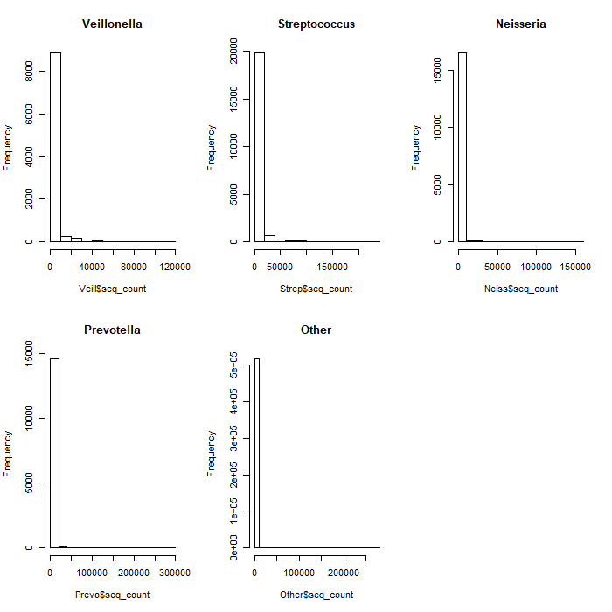
Results: Data Manipulation
Untransformed groups
Notes:
Not even a little bit normal

Slide 22
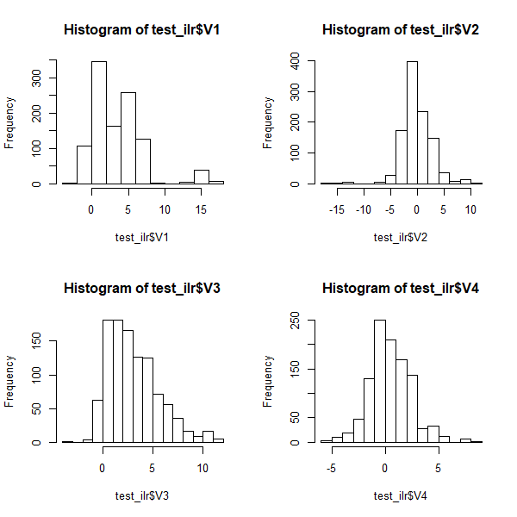
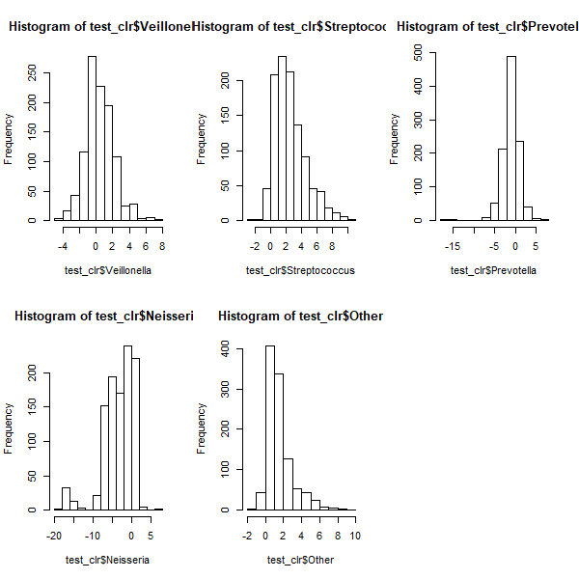
Results: Data Manipulation
ILR Transform
CLR Transform
Notes:
Not perfect but a good improvement;
Some of the CLR groups probably look the least normal, but this wasn’t an issue as we ended up only using Strep

Slide 23
Results: Models Considered
Minimum Observations
Time Measurements
Out of 205 subjects, 5 had 1 sample and 8 had 2 samples
3 sample minimum models had a better fit than those using a minimum of 2
Continuous age and integer age measurements yielded similar results
Age as an integer was used for simplicity
Notes:
The models I fit had a combination of different min obs, time, data transformations, and trajectories, with different numbers of latent classes (up to 10)
Not much info lost when using 3 sample minimum vs 2 sample minimum as well as strictly better model fits across the board
Cts age and integer age yielded similar model results (and in many cases integer age was a better fit)

Slide 24
Results: Models Considered
Transformation
Trajectories
Several multivariate ILR models
Many multivariate CLR did not converge
Streptococcus CLR univariate models fit
Linear trajectory models typically converged, while some spline trajectory models did not
When both trajectory models converge the spline models fit better
Trajectory being allowed to differ between classes also improved fit
Notes:
Mention that tried several combinations of clr groups, but 2 groups or fewer converged, settled on strep
in playing with the different types of fits for trajectory being different, fairly similar results with the simpler model (like random intercept) similar to random intercept random slope
Talk about different spline methods

Slide 25
Results: Models Considered
Model | 1 LC | 2 LC | 3 LC | 4 LC | 5 LC
ILR MV 3Obs Linear | 18539 | 18537 | 18539 | 18542 | 18555
ILR MV 3Obs Spline | ☹ | ☹ | ☹ | ☹ | ☹
CLR Strep Linear | 4007 | 4003 | 4003 | 4007 | 4011
CLR Strep 3Obs Spline | 3777 | 3778 | 3781 | 3785 | 3789
CLR Strep 3Obs Time Cts | 3784 | 3786 | 3789 | 3793 | 3797
CLR Strep 2Obs Spline | 3830 | 3832 | 3835 | 3838 | ☹
Models which converged typically converged up to between 4-6 latent classes
single latent class was usually best fit by AIC
>90 models fit in total considering all different conditions
Subset of Model AIC’s
Notes:
Recall 3 convergence criteria was on stability of log lik, stability of parameters, size of derivatives. For just about all models that did not converge it was because of the derivative criteria. This would either indicate a problem with the algorithm finding the maxima or the likelihood being too (flat) or both
89 models were in various R files; not counting the work I did looking at which splines methods were best or previous git commits

Slide 26
Results: Model Chosen
Univariate CLR transformed Streptococcus outcome
3 observations minimum/Subj
spline trajectories
Discrete time
Random Intercept, Random slope for Age
Age slopes allowed to vary across classes
4 latent classes (n = 2, 12, 125, 52)
Notes:
Mention how we used ~10 AIC as a criteria, but that our selection was more looking at lowest aic across models then maximizing the # lc
Transition to alluvial plot
5 lc model converged but didn’t have any subjects in one of the classes

Slide 27
Model Chosen
Lowest AIC across other model “families” considered
Maximum # latent classes while still maintaining AIC “close” to the single latent class model
20 parameters estimated
Model | 1 LC | 2 LC | 3 LC | 4 LC | 5 LC
CLR Strep 3Obs Spline | 3777 | 3778 | 3781 | 3785 | 3789*

Slide 28
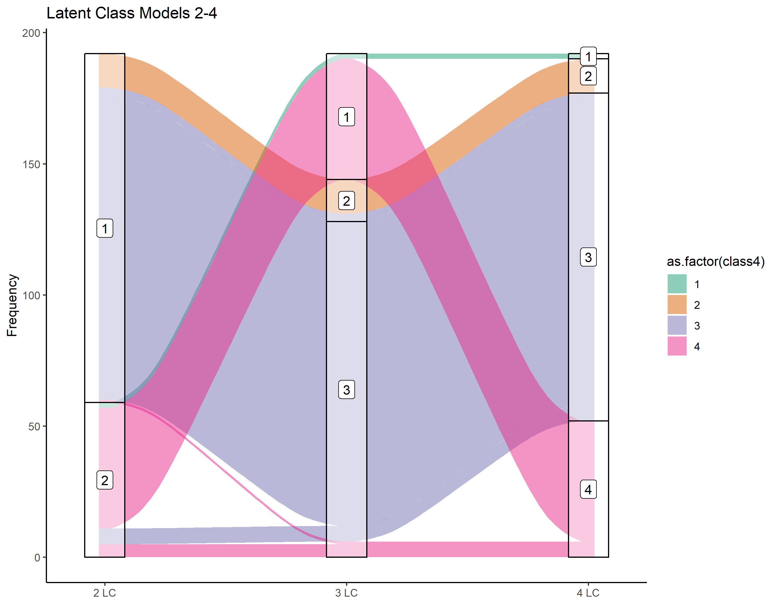
Results: Model Chosen
Classes 2, 3 seem to come from splitting up the larger class in 2 latent class case
Class 1, 4 seems to come from the smaller class
Chosen Model
Notes:
Alluvial plot which shows how the subjects were classified in the multiple latent class models yaxis is # of subjects
Comparison of similar models with different number of latent classes indicate that classes 2, 3 and 4 seem to come from splitting up the larger class in the 2 latent class case, while the majority of class 1 contains the same subjects as the smaller class in the 2 latent class case

Slide 29
Results: Model Fit of Chosen Model
Posterior Classification Table
 | Probability Class 1 | Probability Class 2 | Probability Class 3 | Probability Class 4
Class 1 (n = 2) | 0.86 | 0.00 | 0.00 | 0.14
Class 2 (n = 12) | 0.00 | 0.73 | 0.27 | 0.00
Class 3 (n = 125) | 0.00 | 0.08 | 0.82 | 0.10
Class 4 (n = 52) | 0.05 | 0.00 | 0.17 | 0.78
Mean of posterior probabilities in each class
Subjects classified “a posteriori” in each class
High diagonal values indicate unambiguous classification
Notes:
High diagonal indicates that the model discriminates well with the fourth latent class seeming to be the most ambiguous class with some uncertainty of distinguishing from subjects within classes 1 and 3.

Slide 30
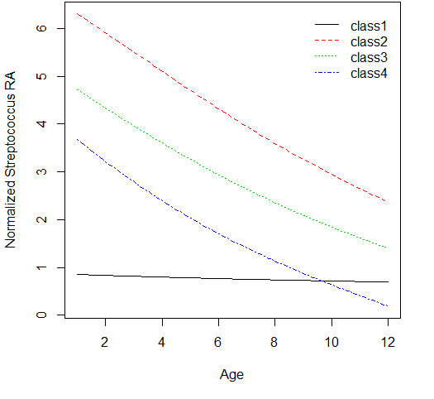
Results: Describing the Latent Classes
Class-Specific Mean Predicted Trajectory
Decreasing trend of Normalized Streptococcus over time
Classes 2, 3, 4 show Strep loss over first year
Differs in starting values and rate of change
Class 1 very different but only 2 subjects
Notes:
Not much we can learn from class 1 because of small n
Seems like an overall decreasing trend was picked up in all of the models (see scatter plot in appendix)

Slide 31
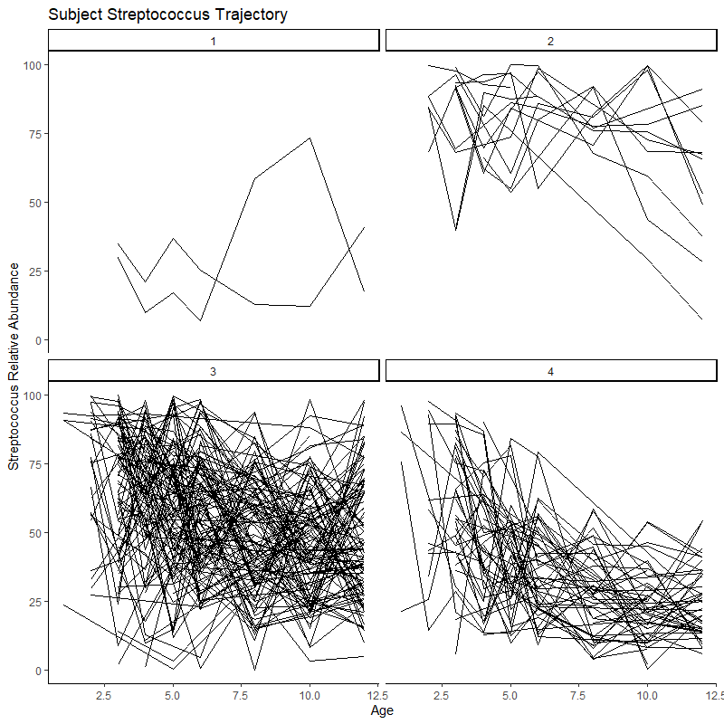
Describing the Latent Classes
Class-Specific Mean Predicted Trajectory
Subject Spaghetti Plots by Class (original RA scale)

Slide 32
Results: Covariates
Results of second stage analysis:
Gender, Meconium Ileus, Age of first antibiotics, Feeding type, antibiotics status, and cumulative antibiotics days are significantly different between classes
Chosen model failed to converge including these class related covariates
Some subsets converged with model tinkering
None significantly associated with the classes
Notes:
CALAMITOUS DISASTER AKIN TO POMPEII
If we tinker with the splines, subset of covariates, and fewer latent classes, it sometimes works
Even without the tiny classes it still had problems; maybe because of some 0 cells or time varying covariates

Slide 33
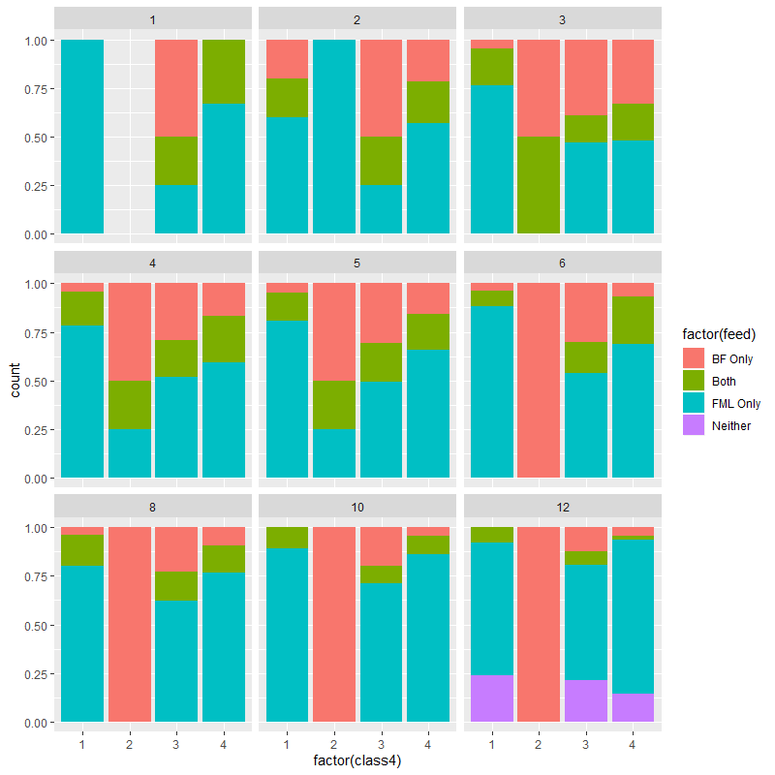
Results: Covariates
Despite result, relationship between feeding type of the infants and latent class was of interest
Latent classes appear to have different feeding types across classes at each time point
Feeding Types Within Latent Classes Over Time
Notes:
This result makes me suspicious of what’s going on in the covariate model as a whole

Slide 34
Discussion
After simplifying microbiome taxa to 4-5 groups, still difficult to obtain results for multivariate model without simplest trajectories
Majority of infants grouped into a single class defined by loss of Streptococcus over time
May be that airway microbiome is homogenous in first year of life
Patients with CF may not diverge until later in life
No strong evidence that clinical covariates were associated with trends in Streptococcus relative abundance over time
Notes:
Subjects deviated from the trend but their numbers were small

Slide 35
Discussion
Lots of different models run; lots did not converge
Of the 3 criteria, it was almost always the derivative criteria
Possible reasons: estimates at boundaries of the parameter space, class-specific covariates that are too high or low (perfect classification); very flat likelihood
Very difficult to balance the increasing number of parameters estimated with an increasingly complex model
Either need very large sample size, and/or a very simple model in mind when implementing this method
Notes:
Most basic Model with 4 latent classes had ~20 parameters estimated; with covariates in fixed effects and class specific effects the number of parameters was sometimes (usually) more than the number of subjects in a latent class; big red flags

Slide 36
Discussion: LCMM package
Very straightforward implementation of many different models
Covariates, Trajectory types, Multivariate, random effects modeling
Built in assessment of the latent class model
Thorough documentation and reproducible examples
Very strict model convergence criteria
High computation times for more complex models (not necessarily packages fault)
Notes:
Mention how in the package lcmm it was easy to look at many different pieces of the model, from regular covariates to covariates associated with the latent classes themselves
Lots of models didn’t really converge (not sure if it’s the lack of data or the strict requirements on the algorithm)

Slide 37
Future work
Still optimistic about the utility of this method in airway microbiomes
This study alone provides several other potential avenues: other taxa, multivariate, etc
More complex modeling of the trajectories (more focused first aim) to better understand Strep’s trajectory over time
Lots of work in optimizing the balance of parameters estimated and model complexity
Comparing this method more in depth to two stage models and other Structural equation modeling methods (simulation to be done?)

Slide 38
Works Cited
Aitchison, J. (1982). The Statistical Analysis of Compositional Data. Journal of the Royal Statistical Society. Series B (Methodological), 44(2), 139–177. JSTOR.
Bacharier, L. B., Beigelman, A., Calatroni, A., Jackson, D. J., Gergen, P. J., O’Connor, G. T., Kattan, M., Wood, R. A., Sandel, M. T., Lynch, S. V., Fujimura, K. E., Fadrosh, D. W., Santee, C. A., Boushey, H., Visness, C. M., Gern, J. E., & NIAID sponsored Inner-City Asthma Consortium. (2019). Longitudinal Phenotypes of Respiratory Health in a High-Risk Urban Birth Cohort. American Journal of Respiratory and Critical Care Medicine, 199(1), 71–82. https://doi.org/10.1164/rccm.201801-0190OC
Cystic Fibrosis Trust. (n.d.). Symptoms of cystic fibrosis. Lungs and Cystic Fibrosis. https://www.cysticfibrosis.org.uk/what-is-cystic-fibrosis/how-does-cystic-fibrosis-affect-the-body/symptoms-of-cystic-fibrosis/lungs
Farrell, P. M., White, T. B., Ren, C. L., Hempstead, S. E., Accurso, F., Derichs, N., Howenstine, M., McColley, S. A., Rock, M., Rosenfeld, M., Sermet-Gaudelus, I., Southern, K. W., Marshall, B. C., & Sosnay, P. R. (2017). Diagnosis of Cystic Fibrosis: Consensus Guidelines from the Cystic Fibrosis Foundation. The Journal of Pediatrics, 181, S4-S15.e1. https://doi.org/10.1016/j.jpeds.2016.09.064
Goetz, D., Kopp, B. T., Salvator, A., Moore‐Clingenpeel, M., McCoy, K., Leung, D. H., Kloster, M., Ramsey, B. R., Heltshe, S. H., & Borowitz, D. (2019). Pulmonary findings in infants with cystic fibrosis during the first year of life: Results from the Baby Observational and Nutrition Study (BONUS) cohort study. Pediatric Pulmonology, 54(5), 581–586. https://doi.org/10.1002/ppul.24261
Hoppe, J. E., Wagner, B. D., Accurso, F. J., Zemanick, E. T., & Sagel, S. D. (2018). Characteristics and outcomes of oral antibiotic treated pulmonary exacerbations in children with cystic fibrosis. Journal of Cystic Fibrosis, 17(6), 760–768. https://doi.org/10.1016/j.jcf.2018.05.015
Lee, E., Lee, S. H., Kwon, J.-W., Kim, Y.-H., Yoon, J., Cho, H.-J., Yang, S.-I., Jung, Y.-H., Kim, H. Y., Seo, J.-H., Kim, H. B., Lee, S. Y., Kwon, H.-J., & Hong, S.-J. (2017). Persistent asthma phenotype related with late-onset, high atopy, and low socioeconomic status in school-aged Korean children. BMC Pulmonary Medicine, 17(1), 45. https://doi.org/10.1186/s12890-017-0387-5
Mandal, S., Van Treuren, W., White, R. A., Eggesbø, M., Knight, R., & Peddada, S. D. (2015). Analysis of composition of microbiomes: A novel method for studying microbial composition. Microbial Ecology in Health & Disease, 26(0). https://doi.org/10.3402/mehd.v26.27663
Proust-Lima, C., Philipps, V., & Liquet, B. (2017). Estimation of Extended Mixed Models Using Latent Classes and Latent Processes: The R Package lcmm. Journal of Statistical Software, 78(2). https://doi.org/10.18637/jss.v078.i02
Son, J. S., Zheng, L. J., Rowehl, L. M., Tian, X., Zhang, Y., Zhu, W., Litcher-Kelly, L., Gadow, K. D., Gathungu, G., Robertson, C. E., Ir, D., Frank, D. N., & Li, E. (2015). Comparison of Fecal Microbiota in Children with Autism Spectrum Disorders and Neurotypical Siblings in the Simons Simplex Collection. PLOS ONE, 10(10), e0137725. https://doi.org/10.1371/journal.pone.0137725
Taddé, B. O., Jacqmin‐Gadda, H., Dartigues, J., Commenges, D., & Proust‐Lima, C. (2019). Dynamic modeling of multivariate dimensions and their temporal relationships using latent processes: Application to Alzheimer’s disease. Biometrics, biom.13168. https://doi.org/10.1111/biom.13168
Turnbaugh, P. J., Ley, R. E., Hamady, M., Fraser-Liggett, C. M., Knight, R., & Gordon, J. I. (2007). The Human Microbiome Project. Nature, 449(7164), 804–810. https://doi.org/10.1038/nature06244
Xu, L., Paterson, A. D., & Xu, W. (2017). Bayesian latent variable models for hierarchical clustered count outcomes with repeated measures in microbiome studies: Xu et al. Genetic Epidemiology, 41(3), 221–232. https://doi.org/10.1002/gepi.22031

Slide 39
Sample R Code
model_aim2 = gridsearch(
lcmm(Streptococcus ~ Age,
classmb = ~ feed,
random = ~ Age, subject = "patient_id",
ng = 4,
mixture = ~ Age,
link = "5-quant-splines", data = BONUS_al3),
rep = 15, maxiter =30, minit = cov_init_mod)

Slide 40
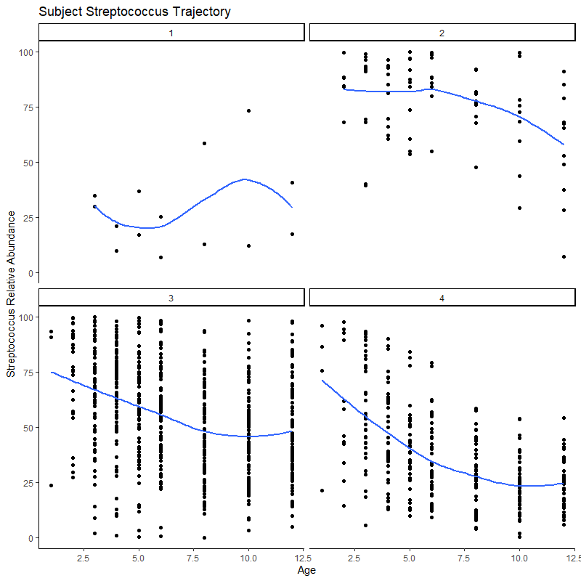
Misc Figure: Spaghetti/Scatter w/LOESS in RA scale

Slide 41
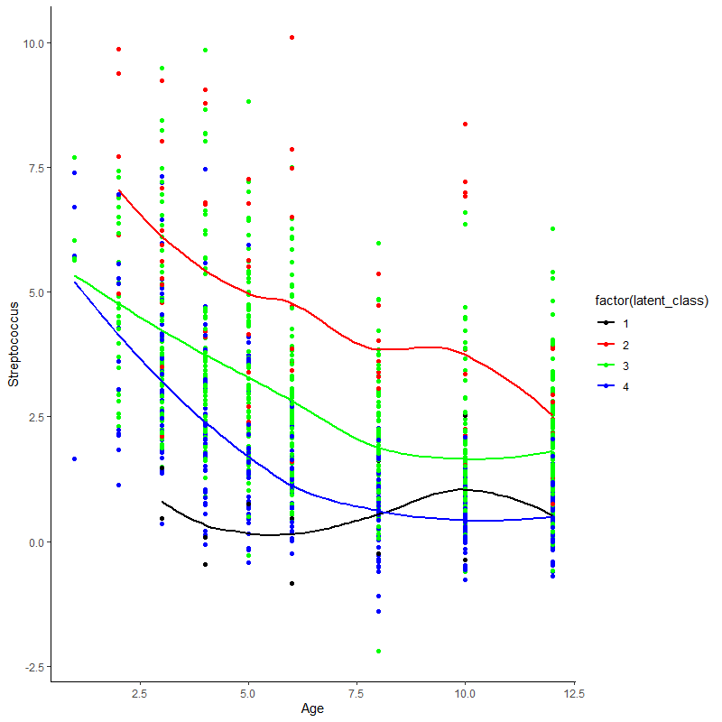
Misc Figure: Scatter w/LOESS overlay

Slide 42
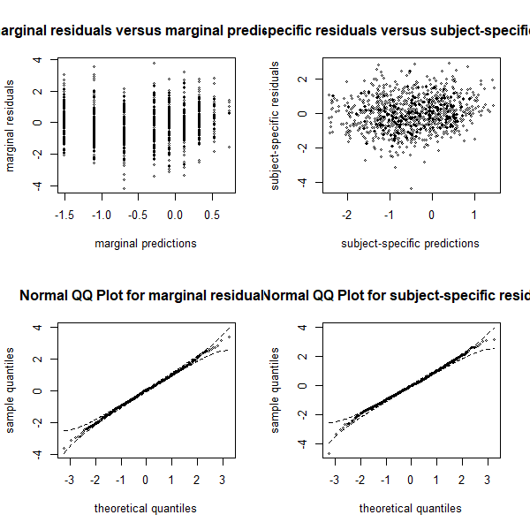
Misc Results: Model Fit
Residuals look evenly centered around 0
Possible divergence from normality at extreme values in sample
Notes:
residuals

